Slide 3
Topic of our lesson
These games have an interesting and long history.
It is a holiday which is held every four years.
These games may be winter and summer.
It is the most important international sport event.

Slide 4
Topic of our lesson

Slide 5
The Olympic Games

Slide 6
Translate some phrases
An important competition
To join a team
To score a goal
To support a team
The International Olympic Committee
To take part in Ancient Greece

Slide 7
let’s play
It’s a team game.
Each team has ten players and one goalkeeper.

Slide 8
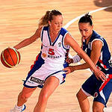
let’s play

Slide 9
let’s play
It’s a team game. Each team has five players and one goalkeeper. The sportsmen play on the ice. It’s winter kind of sport.

Slide 10
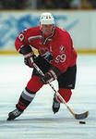
let’s play

Slide 11
let’s play
It’s a team game. Each team has five players. They play in the gym. The players try to throw a ball into the basket.

Slide 12
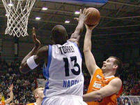
let’s play

Slide 13
let’s play
It’s a team game. Each team has six players. They throw the ball throw the net.They play in the gym.

Slide 14
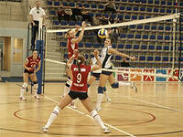
let’s play

Slide 15
let’s play
The main idea is to move an athlete or a pair of athletes skating on ice with changes in the direction of sliding and performing additional elements.

Slide 16
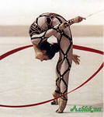
let’s play

Slide 17
Check yourself
1…….. decided to revive the Olympic Games.
Thomas Bakh
Andrey Sakhrov
Baron Pierre De Coubertin.
2. The Summer Olympic Games were in Russia in…
2004
1980.
2014
3. Women participated in the Olympic Games for the first time in…
1900
1898
2003
4. Where did the Olympic Games begin
England
Rome
Ancient Greece
5. How often are the Olympic Games held?
Every 8 years
Every 4 years
Every 6 years

Slide 18
Check yourself
1…….. decided to revive the Olympic Games.
Baron Pierre De Coubertin.
2. The Summer Olympic Games were in Russia in…
1980.
3. Women participated in the Olympic Games for the first time in…
1900
4. Where did the Olympic Games begin
Ancient Greece
5. How often are the Olympic Games held?
Every 4 years

Slide 19
Home work
At home you should do ex. 6 p. 57. Read the text and arrange its parts in the correct order

Slide 20
What emotions do you feel?

Slide 22
Good-bye!

